Slide 1
Introduction to Hadoop Ecosyatem
Week-2
In this module, you'll gain a fundamental understanding of the Apache Hadoop architecture, ecosystem, practices, and commonly used applications including Distributed File System (HDFS), MapReduce, HIVE and HBase. Gain practical skills in this module's lab when you launch a single node Hadoop cluster using Docker and run MapReduce jobs.
Learning Objectives
Define Hadoop, review its history, including its relationship with Big Data processing and some of its challenges.
Explain MapReduce, including its applications, components, and use cases.
List the stages of the Hadoop ecosystem and identify some of tools used in each stage.
Differentiate between Hadoop’s core and extended components.
Explain the Hadoop Distributed File System (HDFS), identify its key features, and describe its architecture.
Describe Hive’s uses, features, and architecture.
Compare and contrast HBase to HDFS.
Describe HBase and its features, uses, architecture, and concepts.
Compare and contrast Hive to traditional relational database management systems.
Run a single-node Hadoop instance.
Perform a word count by using Hadoop Map Reduce.

Slide 2
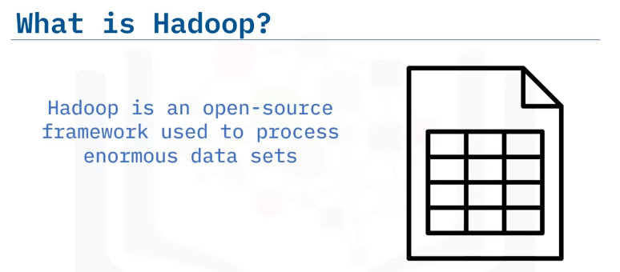
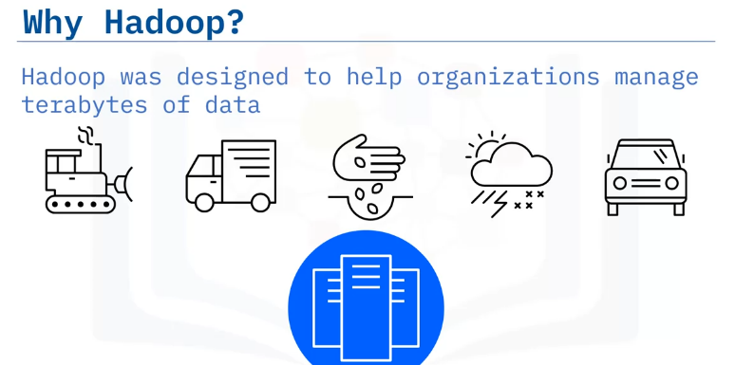
Define Hadoop,
explain the history of Hadoop,
list reasons why Hadoop was the answer to Big Data processing,
outline some of the challenges of Hadoop.
Introduction to Hadoop
You have one gigabyte of data that you need to process, perhaps customer sales records or survey responses.
The data is stored in a relational database on your desktop computer or laptop.
Neither device has a problem handling this data set and you can query the data with ease.
You have a great year, and you pick up a few more clients.
Your company starts growing very quickly, and that data grows to ten gigabytes. then 100 gigabytes.
Data size grows from 1GB→10GB→100GB
You pick up a big client, a retailer perhaps, with multiple databases.
Maybe you are a mine manager and a new executive decision means that you must now start processing data from equipment, front end loaders, excavators, and haul trucks.
You also have data about the environment, data about soil and weather, and data about safety and rock samples Or perhaps your company is a delivery service, and you attach sensors to your entire fleet.
Overnight your clients, drivers, and their vehicles all start gathering data that you now need to process!
When your data grows from 1 terabyte to 10 terabytes, and then 100 terabytes, you are again quickly approaching the limits of your local computers.
Data size grows from 1TB→10TB→100TB

Slide 3
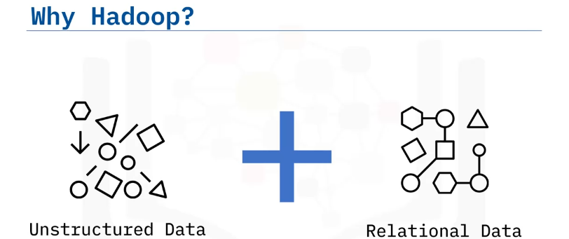
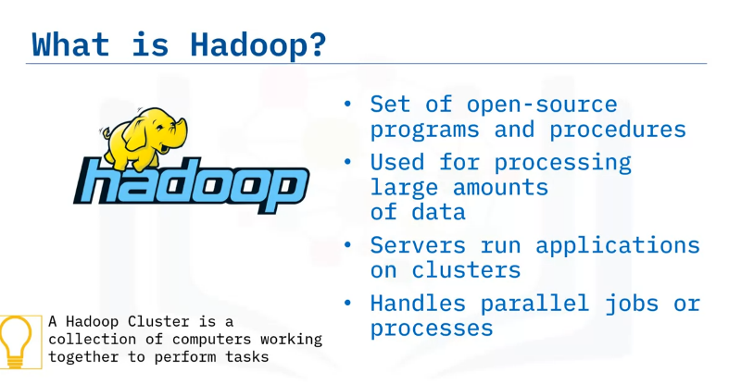
And maybe you need to process unstructured data coming from sources like Facebook, Twitter, sensors, and so on.
The senior leadership team at your company wants to derive insights from both the relational data and the unstructured data in order to make informed decisions.
And they want this information as soon as possible. How can you accomplish this task? Hadoop might be the answer.
Hadoop is a set of open-source programs and procedures which can be used as the framework for Big Data operations.
It is used for processing massive data in distributed file systems that are linked together.
It allows for running applications on clusters.
A cluster is a collection of computers working together at the same to time to perform tasks.
It should be noted that Hadoop is not a database but an ecosystem that can handle processes and jobs in parallel or concurrently.
Hadoop is optimized to handle massive quantities of data which could be: Structured, tabular data, Unstructured data, such as images and videos, or Semi-structured data, using relatively inexpensive computers.

Slide 4
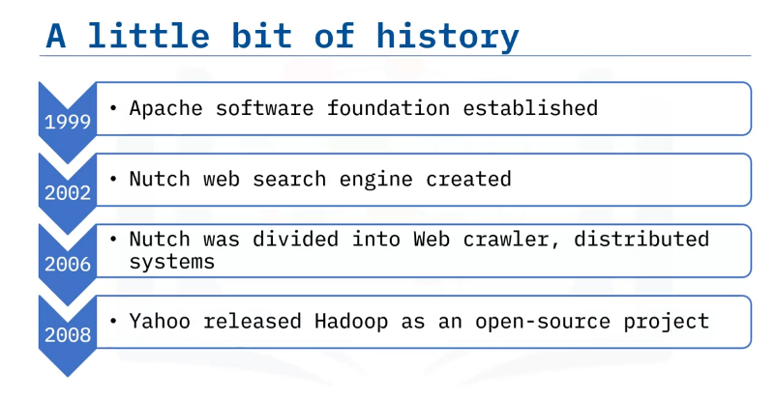
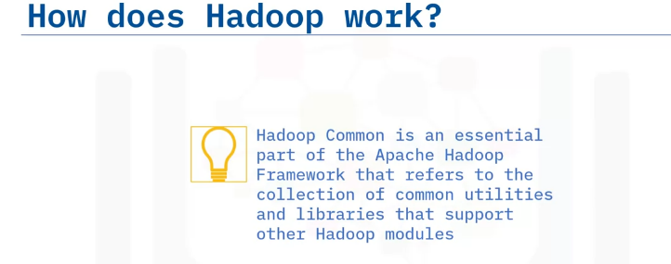
In the 1990s coming into the new Millennium, the web grew significantly to millions of pages and different structures of data.
Automation was needed to help handle simultaneously the differences in data structure and the web searches.
In 1999, the Apache Software foundation was established as a non-profit.
In 2002, the Nutch web search engine was created by Doug Cutting and Mike Cafarella.
Nutch was created on the basis that it could handle multiple tasks across different computers at the same time, while storing and processing the data in a distributed way, so that the most relevant search would be returned faster.
In 2006, Cutting joined Yahoo with the Nutch project, and the project was divided into the web crawler and distributed processing.
The distributed processing segment was called Hadoop, and in 2008, Yahoo released Hadoop to the Apache Software Foundation.
Data is now in petabytes and exabytes and Big Data is the term used to explain the complexity of the data.
Hadoop has individual components for storing and processing data.
The term Hadoop is often used to refer to both the core components of Hadoop as well as the ecosystem of related projects.
The core components of Hadoop include: Hadoop Common, which is an essential part of the Apache Hadoop Framework that refers to the collection of common utilities and libraries that support other Hadoop modules.

Slide 5
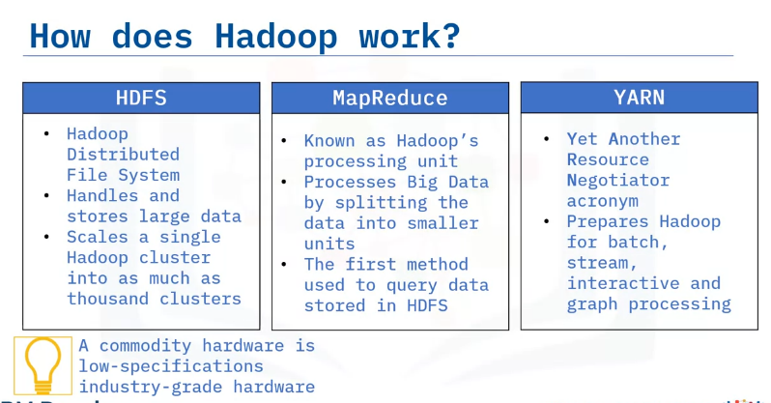
HDFS: Storage
MapReduce: Processes and Queries data to and from nodes
YARN: Resource Negotiator/Manager
There is a storage component called Hadoop Distributed File System, or HDFS. It handles large data sets running on commodity hardware.
A commodity hardware is low-specifications industry-grade hardware and scales a single Hadoop cluster to hundreds and even thousands.
The next component is MapReduce which is a processing unit of Hadoop and an important core component to the Hadoop framework.
MapReduce processes data by splitting large amounts of data into smaller units and processes them simultaneously.
For a while, MapReduce was the only way to access the data stored in the HDFS.
There are now other systems like Hive and Pig.
And the last component is YARN, which is short for “Yet Another Resource Negotiator.”
YARN is a very important component because it prepares the RAM and CPU for Hadoop to run data in batch processing, stream processing, interactive processing, and graph processing, with are stored in HDFS.

Slide 6
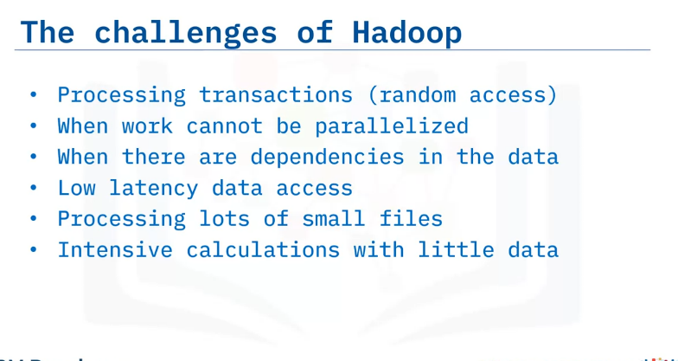
The drawbacks of Hadoop could not be left unnoticed by developers.
Hadoop contained many smaller components. Although efficient at first glance, Hadoop failed at simple tasks.
Hadoop is not good for processing transactions due to its lack of random access.
Hadoop is not good when the work cannot be done in parallel or when there are dependencies within the data.
Dependencies arise when record one must be processed before record two.
Hadoop is also not good for low latency data access.
“Low latency” allows small delays, unnoticeable to humans, between an input being processed and the corresponding output providing real time characteristics.
This can be especially important for Internet connections utilizing services such as trading, online gaming, and Voice Over IP.
Hadoop is also not good for processing lots of small files, although there is work being done in this area such as IBM’s Adaptive MapReduce.
Lastly, Hadoop is not good for intensive calculations with little data.
To deal with the shortcomings of Hadoop, new tools like Hive were built on top of Hadoop.
Hive provided SQL-like query and provided users with strong statistical functions.
Pig was popular for its multi query approach to cut down the number of times that the data is scanned.

Slide 7
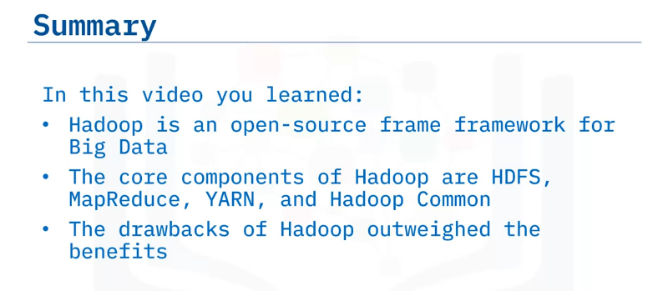

Slide 8
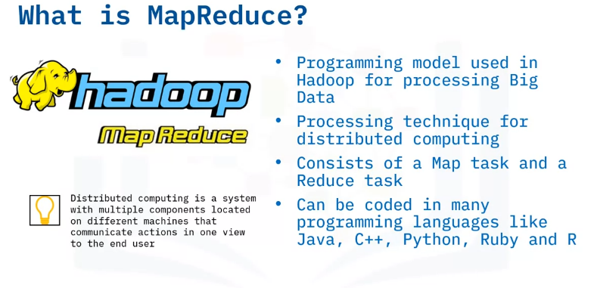
Explain the terms Map and Reduce in MapReduce,
describe why we use MapReduce,
list the components of MapReduce,
outline examples of common use cases of MapReduce
Intro to MapReduce
MapReduce is a programming pattern that enables massive scalability across hundreds or thousands of servers in a Hadoop cluster.
As the processing component, MapReduce is the heart of Apache Hadoop.
MapReduce is a processing technique and a program model for distributed computing, it is based on Java.
Distributed computing is a system or machine with multiple components located on different machines.
Each component has its own job, but the components communicate with each other to run as one system to the end user."
The MapReduce algorithm consists of two important tasks - Map and Reduce.
Many MapReduce programs are written in Java. MapReduce can also be coded in C++, Python, Ruby, R and so on.

Slide 9
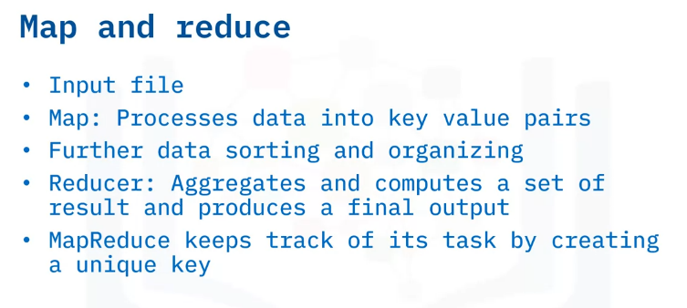
The MapReduce framework contains two tasks, Map and Reduce.
Map takes in an input file and performs some mapping tasks by processing and extracting important data information into a key value pairs and these are the preliminary output list.
Some more reorganization goes on before the preliminary output is sent to the Reducer.
The Reducer works with multiple map functions and aggregates the pairs using their keys to produce a final output.
MapReduce keeps track of its tasks by creating unique keys to ensure that all the processes are solving the same problem.

Slide 10
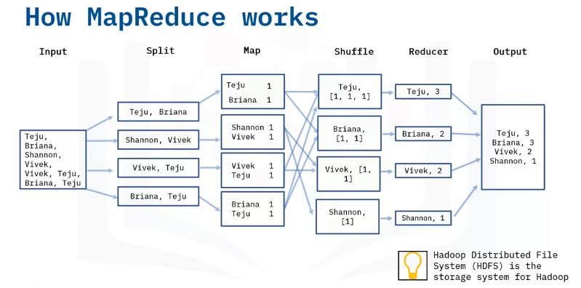
Let us look at the framework visually.
First, we have the Map step, which takes a set of data and converts it into another set of data, where individual elements are broken down into key/value pairs.
The key is the name, and the value is the content.
The input data is a file that is saved in the Hadoop file system called HDFS.
Now let’s assume we have an input file that contains names of people, and we would like to do a word count on the unique name occurrences.
First, the data is split into the following four files, each of them in key value pair and are worked on separately.
For example, for the first split line for Teju and Briana, we have two key value pairs with one occurrence in each file, and it will do the same for all of key value pairs.
We then have the reducer; the reducer processes the data that comes from the map.
After processing, it produces a new set of outputs, which will be stored in the HDFS.
The Reducer starts with shuffling.
Shuffling sorts the key and a list of values in a list, for example, you will see the Key Teju and the corresponding list of values from the previous step.
We will have Teju [1, 1, 1], This is because the name Teju occurred 3 times in the “Map” step.
It does the same for the rest of the names, counting how many times they appeared in the “Map” step.
The Reducer layer then aggregates the values in the list and saves them, then the final output is saved in an output file.

Slide 11
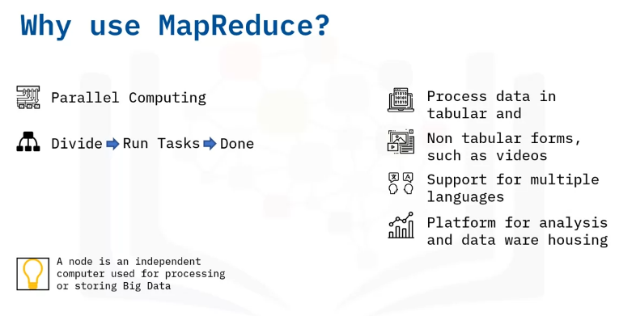
The advantages of MapReduce is its ability to allow for a high level of parallel jobs across multiple nodes.
A node is an independent computer used for processing and storing big volumes of data.
In Hadoop we have two types of nodes, the name node and the data node.
Map reduce allows for splitting and running independent tasks in parallel by dividing each task which in turn saves time.
MapReduce is very flexible and can process data that come in tabular and non-tabular forms.
Therefore, MapReduce provides business value to organizations regardless of how their data is structured.
It also offers support for different languages and provides a platform for analysis, data warehousing and more.
MapReduce has a couple of use cases and here we have some of them displayed.

Slide 12
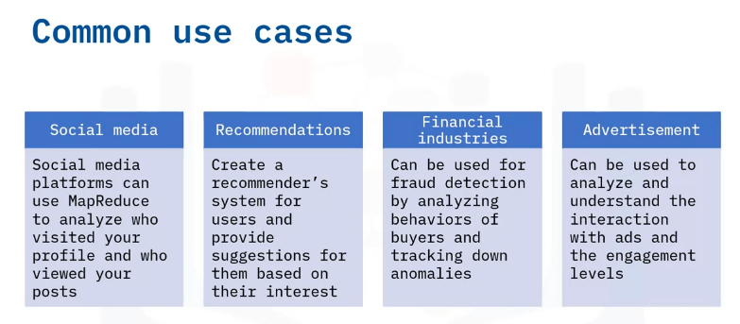
Of MapReduce
MapReduce can be used for social media platforms like LinkedIn and Instagram to analyze who visited, viewed, and interacted with your profile posts.
Map reduce is used by Netflix to recommend movies based on what you have watched in the past by using the user's interests.
It is also used in financial institutions like banks and credit card companies to flag and detect anomalies in user transactions.
It can also be used in the advertisement industry to understand a user’s behavior by how they engage with ads. [sentiment analysis]
Google ads work by using MapReduce to understand the engagement of users with an ad.

Slide 13
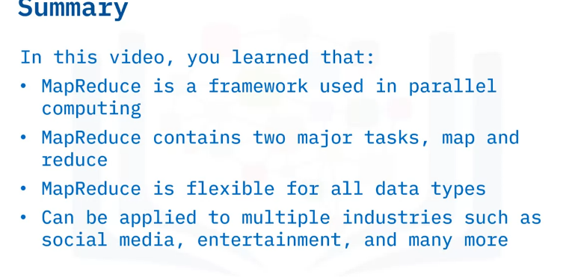

Slide 14
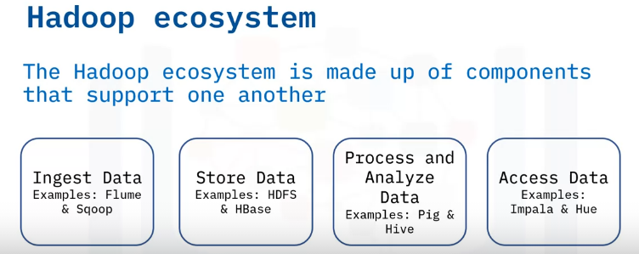
List the stages of the Hadoop Ecosystem,
differentiate between the core components and the extended components,
list some examples of tools used in each stage
Hadoop Ecosystem
Apart from the core components of Hadoop, Hadoop Common refers to the common utilities and libraries that support the other Hadoop modules.
Hadoop Distributed File System (HDFS) stores the data collected from the ingestion and distributes the data across multiple nodes.
MapReduce is used for making Big Data manageable by processing them in clusters.
Yet Another Resource Negotiator (YARN) is the resource manager across clusters.
The extended Hadoop Ecosystem consists of libraries or software packages that are commonly used with or installed on top of the Hadoop core.
The Hadoop ecosystem is made up of components that support one another for Big Data processing.
We can examine the Hadoop ecosystem based on the various stages.
data is received from multiple sources, Flume and Sqoop are responsible for ingesting the data & transferring them to the Storage component, HDFS & HBase.
Then, the data is distributed to a MapReduce framework like Pig and Hive to process and analyze the data, and the processing is done by parallel computing.
After all that is done, tools like Hue are used to access the refined data.

Slide 15
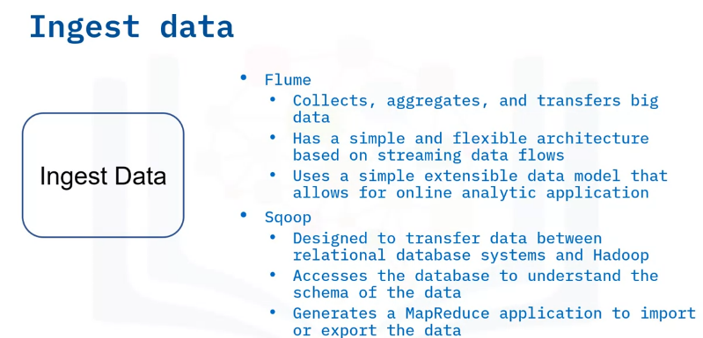
Whenever you deal with big data, you get data from different sources.
You then use tools like Flume and Sqoop.
Flume is a distributed service that collects, aggregates, and transfers Big Data to the storage system.
Flume has a simple and flexible architecture based on streaming data flows and uses a simple extensible data model that allows for online analytic application.
Sqoop is an open-source product designed to transfer bulk data between relational database systems and Hadoop.
Sqoop looks in the relational database and summarizes the schema.
It then generates MapReduce code to import and export data as needed.
Sqoop allows you to quickly develop any other MapReduce applications that use the records that Sqoop stored into HDFS.

Slide 16
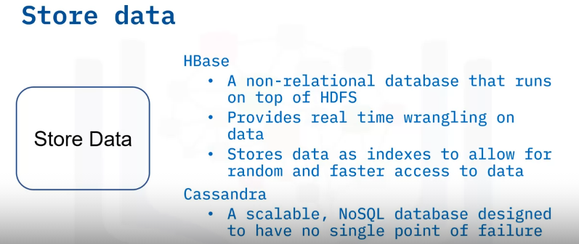
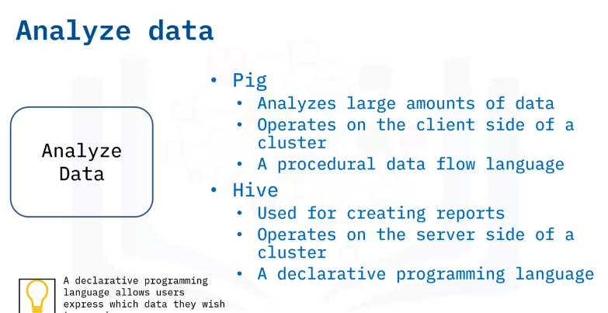
HBase is a column-oriented non-relational database system that runs on top of HDFS.
It provides real time wrangling access to the Hadoop file system.
HBase uses hash tables to store data in indexes and allow for random access of data, which makes lookups faster.
Cassandra is a scalable, NoSQL database designed to have no single point of failure.
In the Analyze Data stage, Pig is used for analyzing large amounts of data.
Pig is a procedural data flow language and a procedural programming language that follows an order and set of commands.
Hive is used mainly for creating reports and operates on the server side of a cluster.
Hive is a declarative programming language, which means it allows users to express which data they wish to receive.

Slide 17
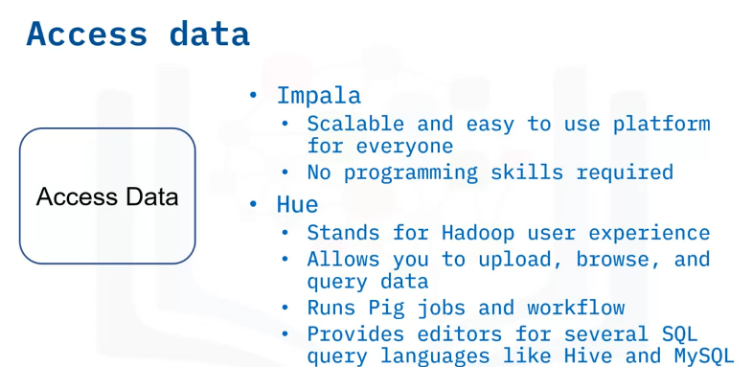
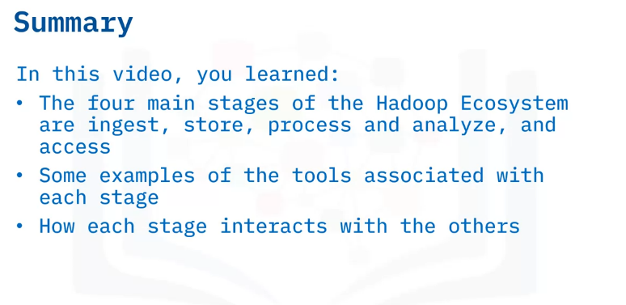
The final stage is “Access data,” where users have access to the analyzed and refined data.
At this stage tools like Impala are often used.
Impala is a scalable system that allows non-technical users to search and access the data in Hadoop.
You do not need to be skilled in programming to use Impala.
And Hue is another tool of choice at this stage.
Hue is an acronym for Hadoop user experience.
Hue allows you to upload, browse, and query data.
You can run Pig jobs and workflow in Hue.
Hue also provides a SQL editor for several query languages like Hive, and MySQL.

Slide 18
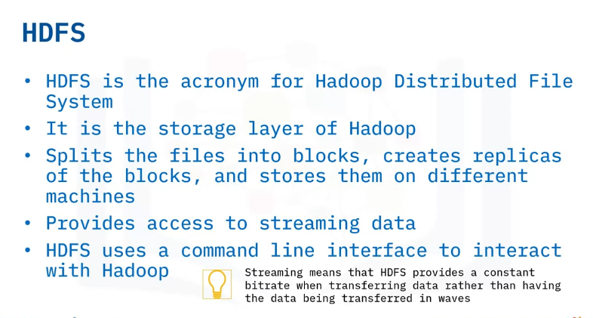
Explain Hadoop Distributed File System and important concepts,
identify the key HDFS features,
describe the HDFS architecture.
HDFS
HDFS stands for Hadoop Distributed File System.
A distributed file system is a file system that is distributed on multiple file servers and allows programmers to access or store files from any network or computer.
HDFS is the storage layer of Hadoop.
HDFS works by splitting the files into blocks, then creating replicas of the blocks, and storing them on different machines.
HDFS is built to access streaming data seamlessly.
Streaming means that HDFS provides a constant bitrate when transferring data rather than having the data being transferred in waves.
HDFS uses a command line interface to interact with Hadoop.

Slide 19
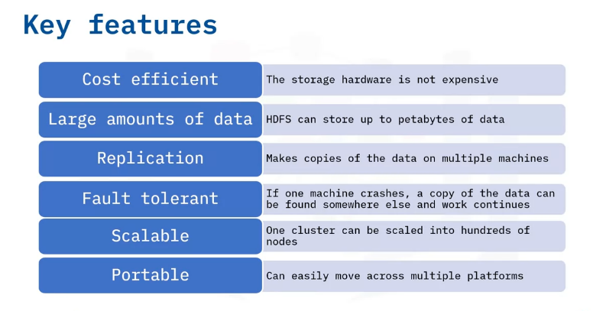
The key features of HDFS are: The commodity hardware that stores the data is not expensive, and therefore reduces storage costs.
HDFS can store very large amounts of data, as large as petabytes— in any format, tabular and non-tabular.
It splits these large amounts of data into small chunks called blocks.
One of the great features of HDFS is its ability to replicate and minimize the costs associated with data losses when there is failure with one of the hardware units.
That capability makes HDFS fault tolerant. In the event of a data loss of one of the computers, the data can be found on another computer and work continues.
HDFS is also highly scalable.
A single cluster can scale into hundreds of nodes.
Portability is also one of the key features, as HDFS is designed to easily move from one platform to another.

Slide 20
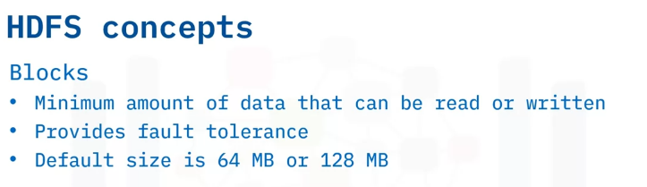
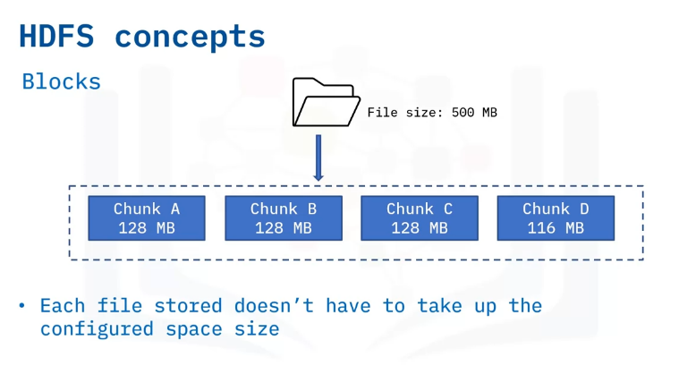
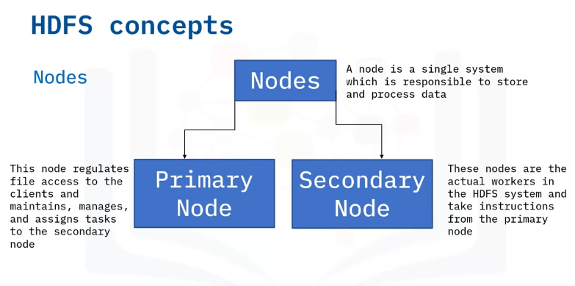
To get familiar with Hadoop, there are a few concepts to know.
When HDFS receives files, files are broken into smaller chunks called blocks.
A block is the minimum amount of data that can be read or written and provides fault tolerance.
Depending on your system configuration, the default block size could be 64 or 128 megabytes.
For example, if we had a 500-megabyte file, with a default block chunk size of 128 megabytes, the file will be divided into 3 blocks of 128 megabytes and one block of 116 megabytes.
The only time you will have equal splits is if the file size is a multiple of the default block size.
Therefore, you can see that each file stored doesn’t have to take up the storage of the pre-configured block size
A node is a single system which is responsible for storing and processing data.
Think about it as one machine or computer in which data is stored.
Remember that HDFS follows the primary/secondary concept.
HDFS has two types of nodes: The Primary node, known as the name node, regulates file access to the clients and maintains, manages, and assigns tasks to the secondary node, also known as a data node.
There can be hundreds of data nodes in the HDFS that manage the storage system.
They perform read and write requests at the instruction of the name node.

Slide 21
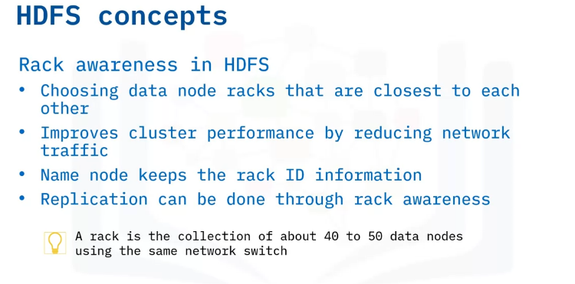
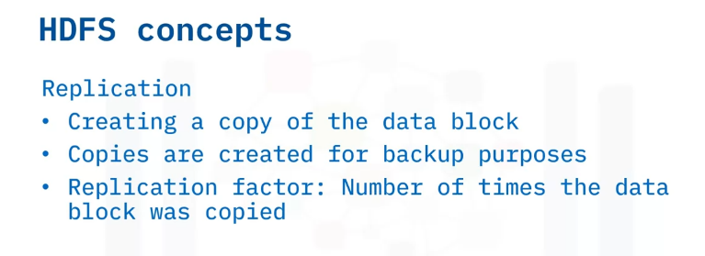
When performing operations like read and write, it is important that the name node maximizes performance by choosing the data nodes closest to themselves.
This could be by choosing data nodes on the same rack or in nearby racks.
This is called rack awareness.
A rack is the collection of about forty to fifty data nodes using the same network switch.
Rack awareness is used to reduce the network traffic and improve cluster performance.
To achieve rack awareness, the name node keeps the rack ID information.
Replication is done by rack awareness as well.
It is done by making sure replicas of a data node are in different racks.
So, if a rack is down, you can still obtain the data from another rack.
HDFS is known for optimizing replication.
HDFS uses the rack awareness concept to create replicas to make sure that the data is reliable and available, and that the network bandwidth is properly utilized.
Replication is creating a copy of the data block.
When crashes happen, replication provides backup of the data blocks.
Replication factor is defined as the number of times you make a copy of the data block.
Depending on your configuration, you can set the number of copies you want.

Slide 22
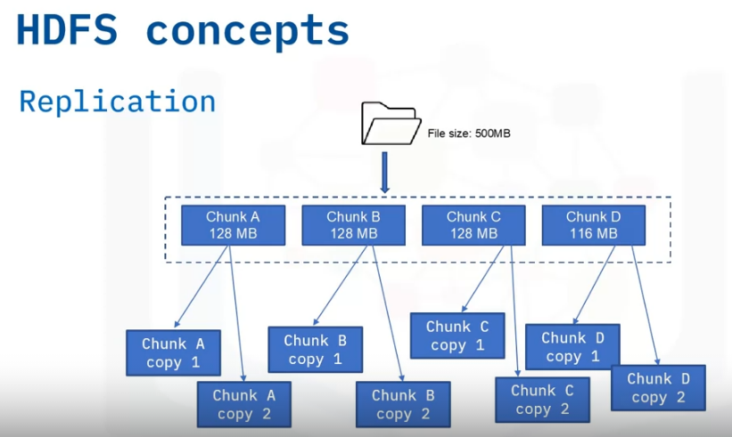
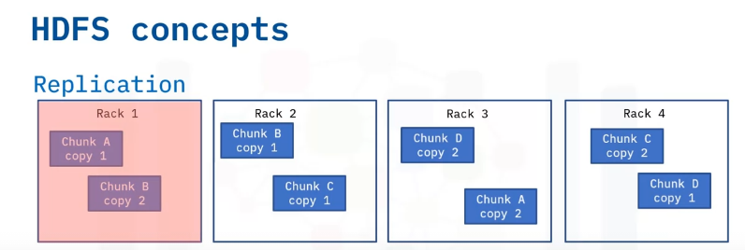
Let us look at our 500-megabyte file example.
If our replication factor is 2, it will create two copies of each block.
That means we will have 4 times 2, which is eight copies of the file blocks for backup.
HDFS uses the rack awareness concept and saves the blocks in different racks to make sure that a copy is available in another rack.
For example, you could have four racks of two copies each.
If one of the racks is down or crashes, you will still have a copy of the data blocks in a different rack, and you can still work with the data.

Slide 23
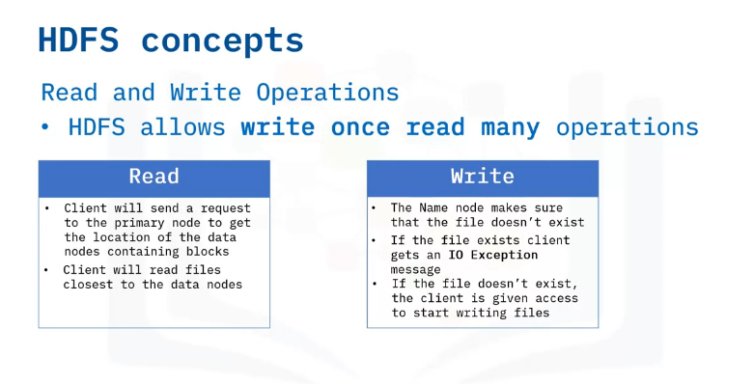
Another important concept is how read and write operations are performed in HDFS.
HDFS allows “write once, read many” operations.
This means that you cannot edit files that are already stored in HDFS, but you can append new data to them.
read operation
Assuming we have a text file, the client will send a request to the primary node, which is the name node, to get the location of the data nodes containing blocks.
The name node will verify that the client has the correct privileges and provide the client with the locations.
A client in HDFS interacts with the primary and secondary nodes to fulfill a user's request.
The client will then send a request to the closest data nodes through an FS Data Input stream object by calling the read method to read all the files.
And when the client is done, the client will use the close method to end the session.
write operation.
Just like in the read operation, the name node confirms that the client has the right privileges.
The name node makes sure to check that the file doesn’t exist in the system.
If the file already exists, the client will receive an IO exception.
If the file doesn’t exist, the client receives a write permission together with the data nodes.
Once the client is done, the data nodes start creating replicas and sends a confirmation to the client.

Slide 24
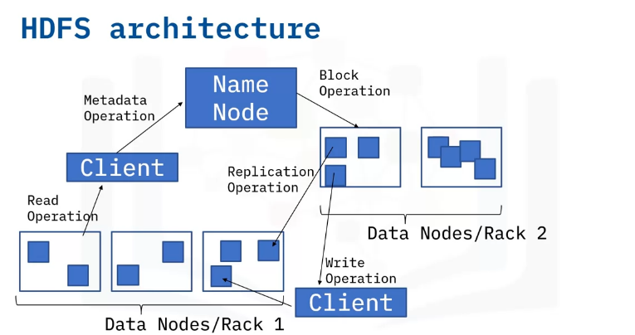
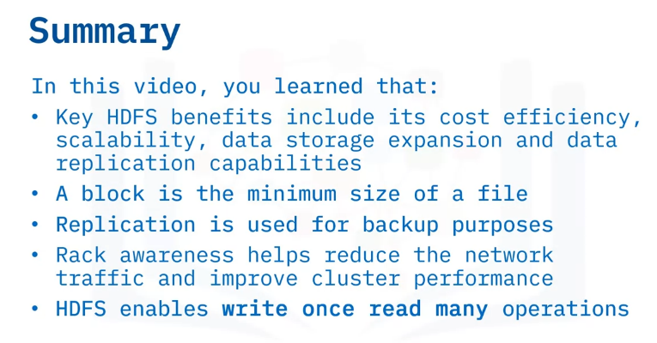
Hadoop follows the concept of a primary/secondary node architecture.
The primary node is the name node. The architecture is such that per cluster, there is one name node and multiple data nodes, which are the secondary nodes.
Internally, a file is split into one or more blocks and these blocks are stored in a set of data nodes./primary nodes
The name node oversees opening, closing, renaming file operations, and mapping file blocks to the data node.
The data nodes are responsible for read and write requests from the client and perform the creation, replication, and deletion of file blocks based on instructions from the name node.

Slide 25
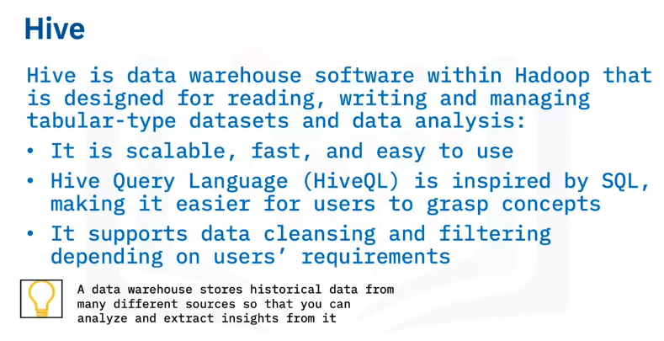
Articulate the reasons why Hive is used,
list Hive features,
differentiate between Hive vs. traditional RDBMS,
identify components of the Hive architecture,
discuss Hive concepts.
HIVE
Hive is a data warehouse software within Hadoop that is designed to read, write, and manage large and tabular-type datasets and data analysis.
A data warehouse stores historical data from many different sources so that you can analyze and extract insights from it.
These insights are used for reporting.
Hive is scalable and fast because it is designed to work on petabytes of data.
It is easy to use if you are familiar with SQL because Hive query language, or Hive QL, is based on SQL.
This makes learning quicker because users who already deal with relational databases can easily grasp the concepts.
Hive supports the following file formats: Sequence files consisting of binary key value pairs, record columnar files that store columns of a table in a columnar database, and text or flat files.
Hive allows for data cleaning and filtering tasks according to users' requirements.

Slide 26
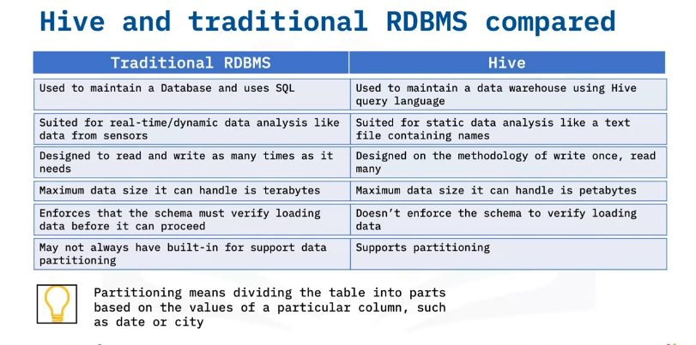
RDBMS is a type of database management system specifically designed for relational databases.
RDBMS is the acronym for Relational Database Management System.
A relational database is a database that stores data in a structured format using rows and columns known as a table.
Let’s look at the differences between a traditional RDBMS and Hive.
Traditional RDBMS is used to maintain a database and uses the structured query language known as SQL.
Hive is used to maintain a data warehouse and uses the Hive query language, a language inspired by SQL.
Traditional RDBMS is suited for real-time data analysis, like data from sensors.
Hive is suited for static data analysis.
Traditional RDBMS allows for as many read and write operations a user needs.
Hive is based on the write once, read many methodology. Traditional RDBMS can handle up to terabytes of data.
Hive is designed to handle as much as petabytes of data.
Another difference is that traditional RDBMS enforces that the schema must verify loading data before it can proceed.
Hive doesn’t enforce the schema to verify loading data.
Lastly, traditional RDBMS may not always have built-in for support data partitioning. Hive supports partitioning.
Partitioning means dividing the table into parts based on the values of a particular column such as date or city.

Slide 27
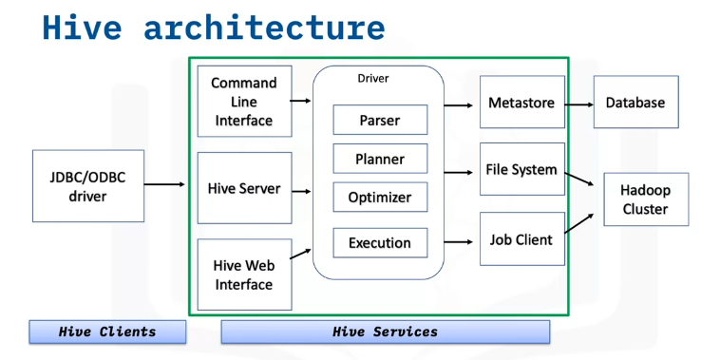
This is what the Hive architecture looks like. There are three main parts of the architecture:
The Hive client: Hive provides different drivers for communication depending on the type of application.
For example, for Java based applications, it uses JDBC drivers, and other types of applications will use ODBC drivers.
These drivers communicate with the servers.
Hive services: Client interactions are done through the Hive services. Any query operations are done here.
The command line interface acts as an interface for the Hive service.
The driver takes in query statements, monitors the progress and life cycle of each session, and stores metadata generated from the query statements.
The meta store stores the metadata, the data and information about each table, such as the location and schema.
The meta store, file system, and job client in turn communicate with Hive storage and computing to perform the following:
Metadata information of tables are stored in some sort of database and query results and data loaded in the tables are stored in Hadoop cluster or HDFS.

Slide 28
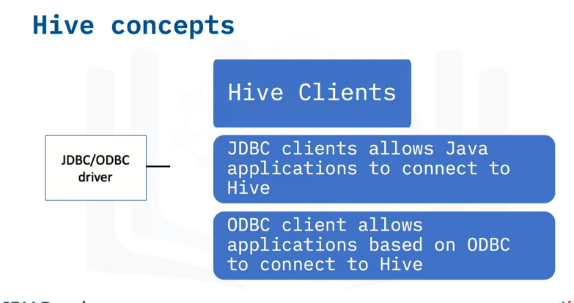
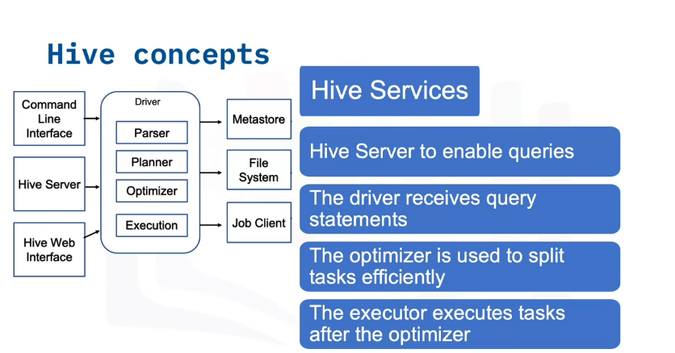
Let’s look at the concepts in detail.
Components in the Hive clients include:
The JDBC client, which allows Java-based applications to connect to Hive, and the ODBC client, which allows applications based on the ODBC protocol to connect to Hive.
The Hive services section of the architecture is in charge of performing queries.
The Hive server is used to run queries and allows multiple clients to submit requests.
It is built to support the JDBC and ODBC clients.
The driver receives query statements submitted through the command line and sends the query to the compiler after initiating a session.
The optimizer performs transformations on the execution plan and splits the tasks to help speed up and improve efficiency.
The executor executes tasks after the optimizer has split the tasks.
The meta store is storage for the metadata, which is information about the table.
The meta store is in charge of keeping this information in a central place.

Slide 29
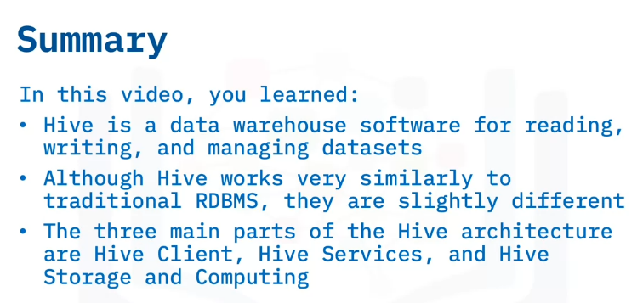

Slide 30
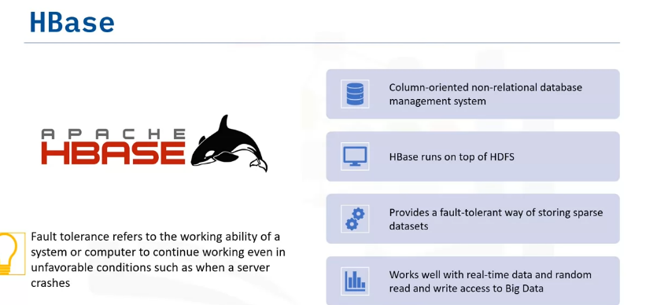
Define HBase,
describe HBase as a columnar database,
list the HBase features and usage,
outline the differences between HBase and HDFS,
describe the HBase Architecture,
discuss HBase concepts.
HBASE
HBase is a column-oriented non-relational database management system that runs on top of Hadoop Distributed File System, or HDFS.
It provides a fault-tolerant way of storing sparse data sets.
Fault tolerance refers to the working ability of a system or computer to continue working even in unfavorable conditions such as when a server crashes.
It works well with real-time data and random read and write access to Big Data.

Slide 31
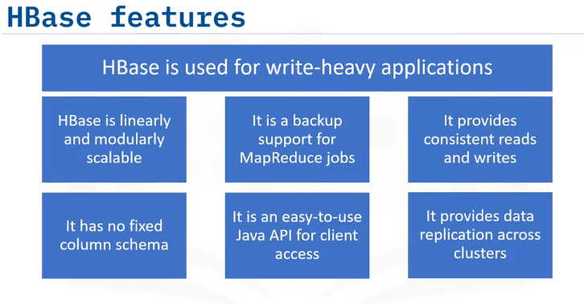
HBase is used for write-heavy applications, to store large amounts of datasets, and process and provide analytics in real time.
It is referred to as linearly scalable because it supports scalability in both linear and modular form.
HBase is a backup support for MapReduce jobs.
HBase can be used for high-speed requirements because it offers consistent reads and writes.
HBase has no fixed columns and is only defined by column families.
It provides an easy-to-use Java API for client access.
HBase supports data replication across clusters.

Slide 32
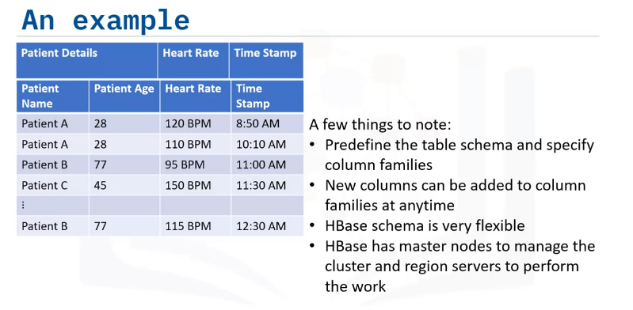
An HBase column represents an attribute of an object.
For example, If the table is storing sensors from heart monitors in the hospital, each row might be a log record.
A typical column could contain information about the patient’s details or the time when the log record was taken.
HBase allows for many attributes to be grouped together into column families such that the elements of a column family are all stored together.
For example, “Patient Name” and “Patient Age” will be stored as ”Patient Details.”
The columns in HBase will look like – Patient Details, Heart Rate, and Time Stamp.
When creating schemas in HBase, you must predefine the table schema and specify the column families.
New columns can be added to families at any time, making the schema flexible and adaptable to changing application requirements.
Just as HDFS has a Name Node and secondary nodes, HBase is built on similar concepts.
In HBase, a primary node manages the cluster and a region server stores portions of the tables and performs the work on the data.

Slide 33
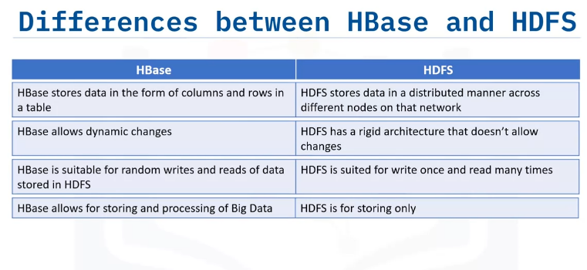
While HBase and HDFS are both used to store massive amounts of data, one of the major differences is that HBase stores data in the form of columns and rows in a table while HDFS stores it in a distributed manner across different nodes on that network.
HBase allows dynamic changes while HDFS has a rigid architecture that doesn’t allow changes.
HBase is suitable for read, write, update, and delete type workloads on a record level.
HDFS is just an underlying level resembling properties of a file system, so is more suited for write once and read in batch workloads.
HBase allows for storing and processing of Big Data while HDFS is for storing only.

Slide 34
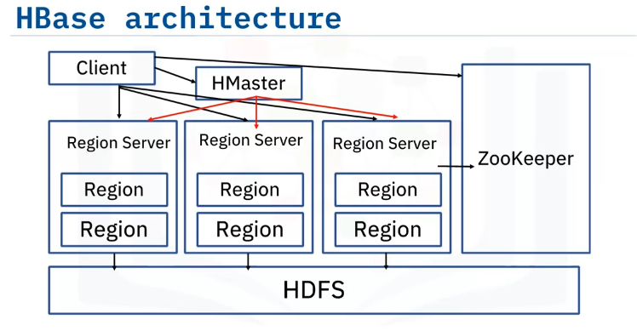
The HBase architecture consists mainly of four components:
1. HMaster
2. HRegionserver
3. HRegions
4. ZooKeeper
From the architecture, we can see that HBase sits and works on top of HDFS.
HDFS provides a distributed environment for the storage, and it is a file system designed to run on commodity hardware. It stores each file in multiple blocks, and to maintain fault tolerance, it replicates the blocks across a Hadoop cluster.

Slide 35
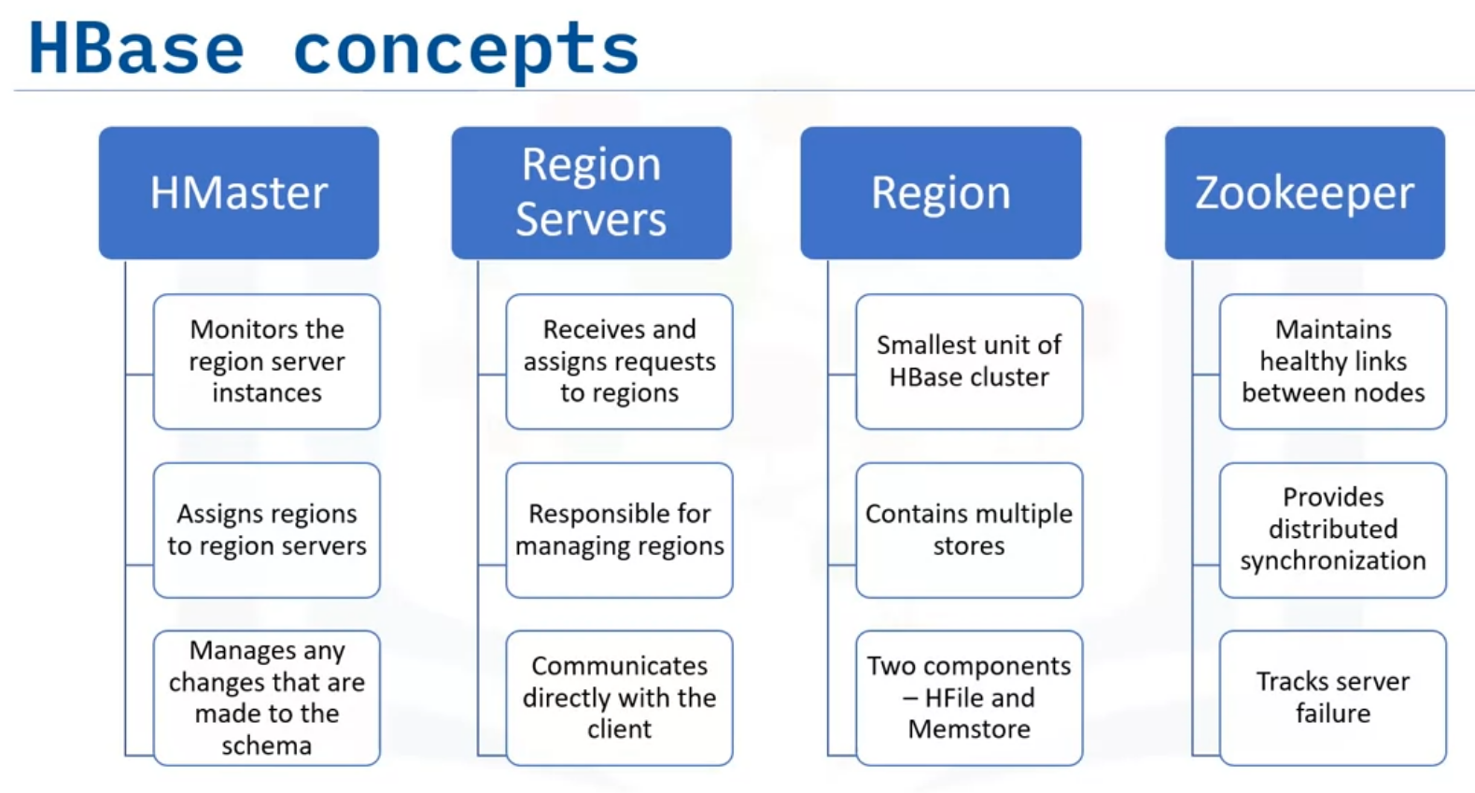
HMaster is the master server. It monitors the region server instances, assigns regions to region servers, and distributes services to different region servers, and manages any changes that are made to the schema and metadata operations.
The region servers receive read and write requests from the client and assign the request to a specific region where the column family resides.
They are responsible for serving and managing regions that are present in a distributed cluster.
Rather than go through HMaster all the time, the region servers can communicate directly with the client to facilitate requests.
The region is the basic building element and smallest unit of the HBase cluster that consist of column families.
It contains multiple stores, one for each column family and has two components – HFile and Memstore.
ZooKeeper is a centralized service for maintaining configuration information to maintain healthy links between nodes.
It provides synchronization across distributed applications and is used to track server failure and network partitions by triggering an error message, and then starts repairing the failed nodes.

Slide 36
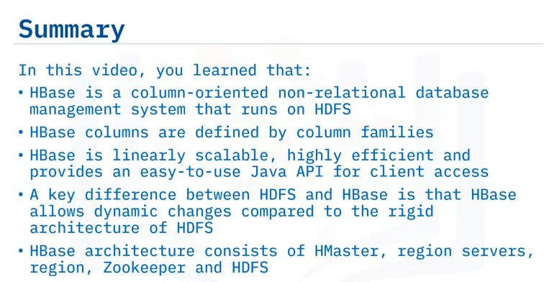

Slide 37
Summary & Highlights
In this module, you learned that:
Hadoop is an open-source framework for Big Data that faced challenges when encountering dependencies and low-level latency.
MapReduce, a parallel computing framework used in parallel computing, is flexible for all data types, addresses parallel processing needs for multiple industries and contains two major tasks, “map” and “reduce.”
The four main stages of the Hadoop Ecosystem are Ingest, Store, Process and Analyze, and Access.
Key HDFS benefits include its cost efficiency, scalability, data storage expansion and data replication capabilities. Rack awareness helps reduce the network traffic and improve cluster performance. HDFS enables “write once, read many” operations.
Suited for static data analysis and built to handle petabytes of data, Hive is a data warehouse software for reading, writing, and managing datasets. Hive is based on the “write once, read many” methodology, doesn’t enforce the schema to verify loading data and has built-in partitioning support.
Linearly scalable and highly efficient, HBase is a column-oriented non-relational database management system that runs on HDFS and provides an easy-to-use Java API for client access. HBase architecture consists of HMaster, Region servers, Region, Zookeeper and HDFS. A key difference between HDFS and HBase is that HBase allows dynamic changes compared to the rigid architecture of HDFS.

